Slide 1
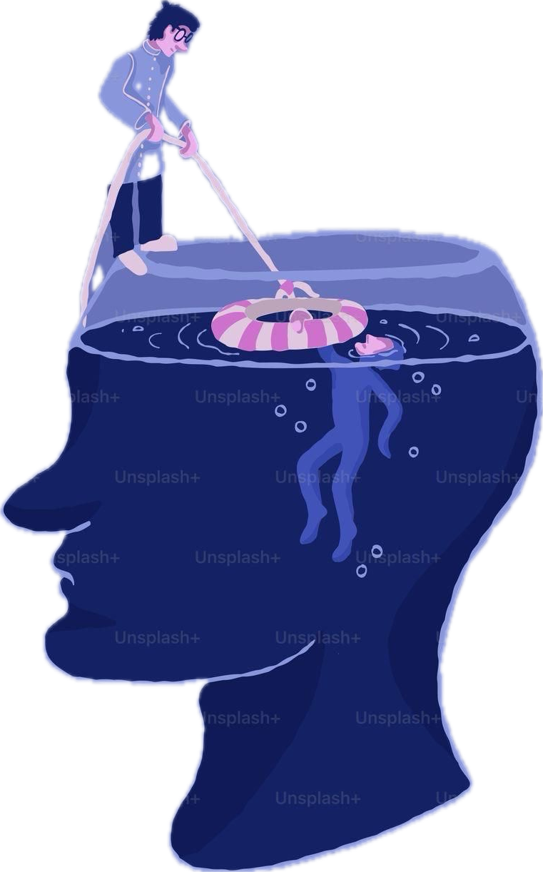
My Department: Psychology
BY:CEREN YILDIZ

Slide 2

My Future Profession: Clinical Psychologist
Why? Human mind is interesting.
Goal: To understand people and help them.
My Strengths: Patient, kind, and a good listener.
Challenge: Confidentiality (keeping secrets safe).

Slide 3
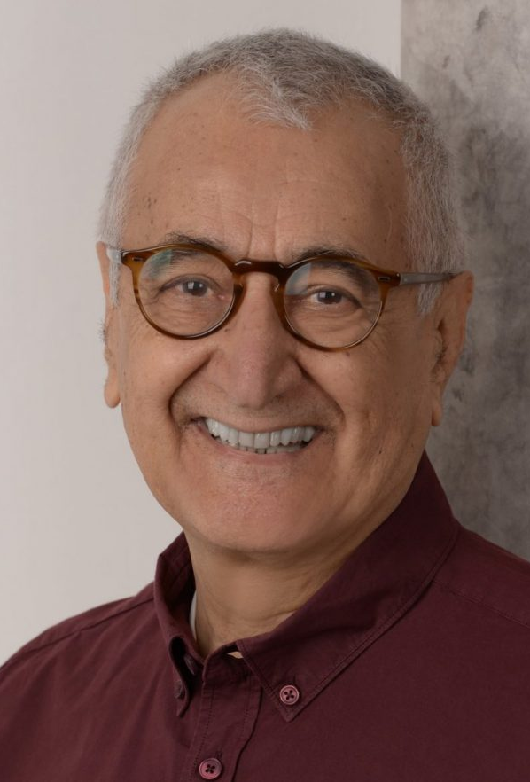
Expert Profile: Doğan Cüceloğlu
• Background: He was a famous expert in communication psychology and human relations.
• Education: He studied at Istanbul University and got his master’s degree in the USA.
• Achievements: He wrote more than 20 books, such as İçimizdeki Çocuk.

Slide 4
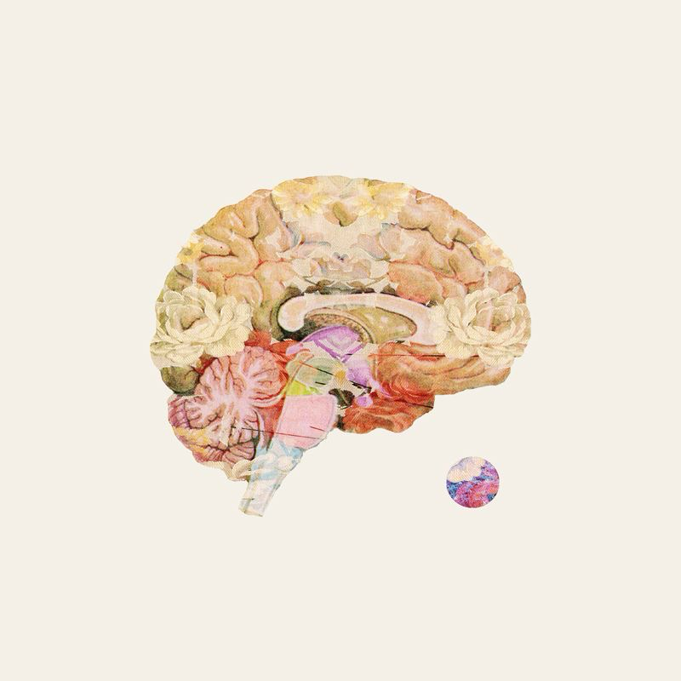
What I Learned from Him
Challenges: He faced hard times in his life and career, but he stayed positive.
Appeal: I like his work because he explained very difficult ideas in a simple way.
Personality: He was a very kind and helpful person to everyone.

Slide 5
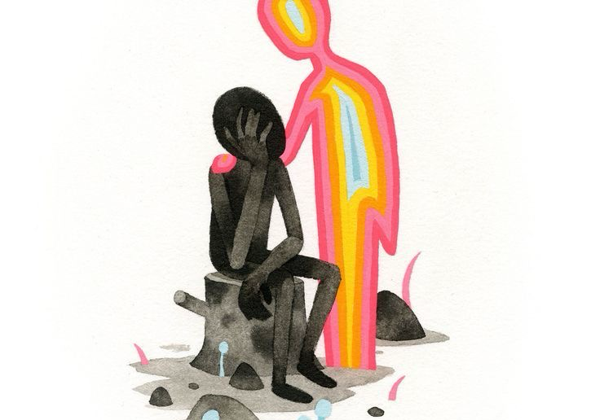
Innovation: Cognitive Behavioral Therapy (CBT)
History: Aaron Beck developed this technique in the USA during the 1960s.
• How it works: It focuses on our thoughts, feelings, and behaviors.
• Advantages: It works very fast, usually in 10-20 sessions, and it doesn't need medicine.
• Limitations: The client must be active and do homework between the sessions.

Slide 6
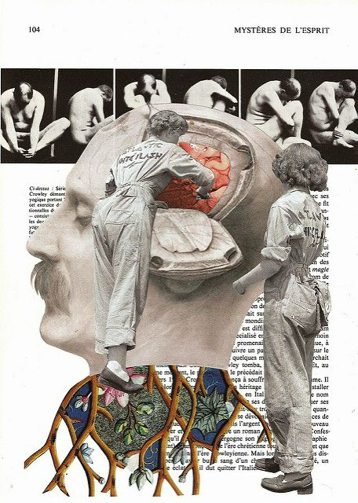
Conclusion: My Future Career
Usage: Learning about CBT will help me help my future clients change their bad thoughts.
Impact: It can reduce anxiety and make people feel better in their lives.
Effectiveness: This technique will make my work as a psychologist more effective.
Thank you for listening.

